Slide 1

Network
Software Architecture and its
Layers and Protocols
CSE306

Slide 2
Network Software
Protocol Hierarchies
Design Issues for the Layers
Connection-Oriented and Connectionless Services
Service Primitives
The Relationship of Services to Protocols

Slide 3
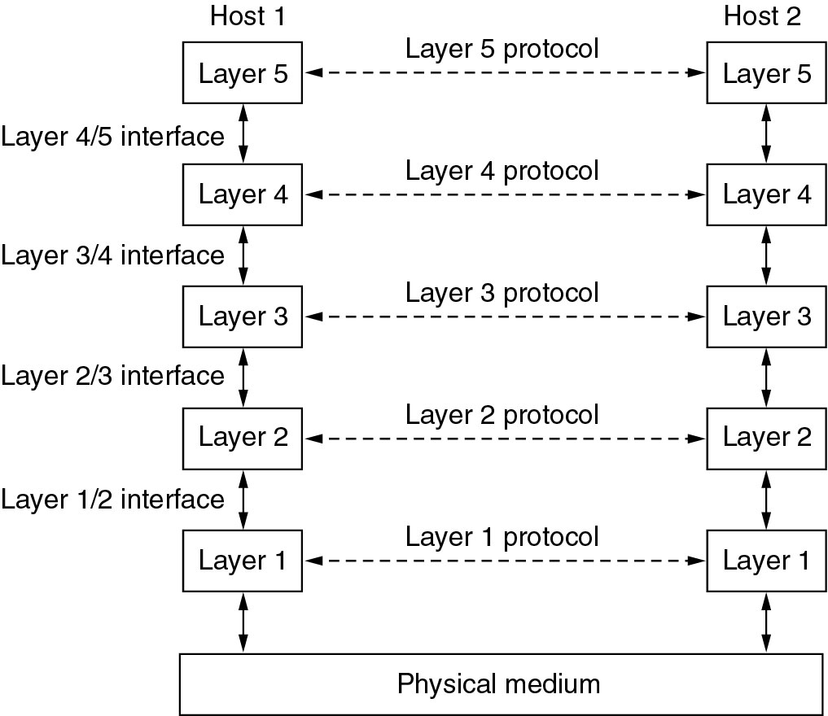
Network Software
Protocol Hierarchies
Layers, protocols, and interfaces- Network Architecture

Slide 4
Protocol – Overview
Rules for how communication proceeds
Used between corresponding layer peers
Peers can be software, hardware, people
Protocol enables peer-to-peer interaction
Protocol stack = , one protocol per layer
Defines communication for entire system
Notes:
A protocol is an agreement between the communicating parties on how communication is to proceed.
The entities comprising the corresponding layers on different machines are called peers. The peers may be software processes, hardware devices, or even human beings. In other words, it is the peers that communicate by using the protocol to talk to each other.
A list of the protocols used by a certain system, one protocol per layer, is called a protocol stack.

Slide 5
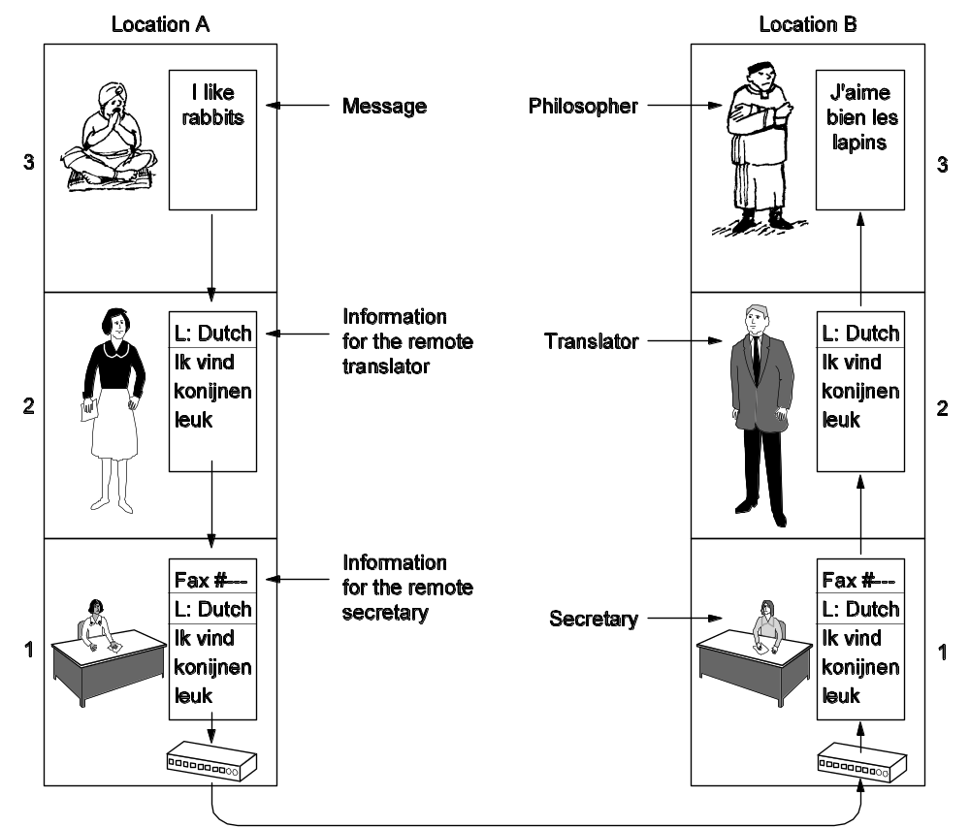
Protocol Hierarchies (2)
The philosopher-translator-secretary architecture.

Slide 6
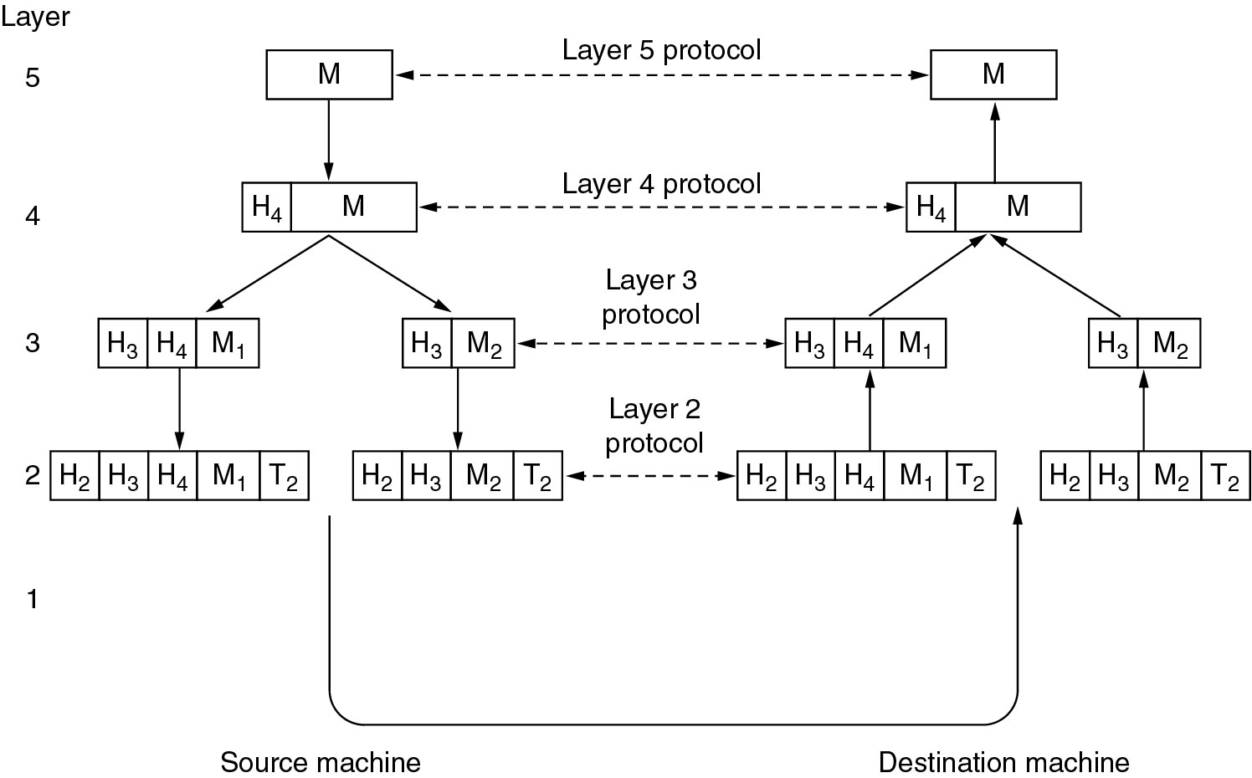
Protocol Hierarchies (3)
Example information flow supporting virtual communication in layer 5.

Slide 7
Design Issues for the Layers
Addressing or naming
Error Control
Flow Control---Congestion
Statistical Multiplexing
Routing

Slide 8
Design Issues for the Layers
Scalable
QoS---real time
Reliability
Security

Slide 9
Lets Play
“When too many packets crowd the way,
Routers drop data, what do we say?”
2. “When the sender goes fast, but receiver is slow,
To match their speed, which control must show?”
Notes:
Congestion
Flow

Slide 10
Connection-Oriented and Connectionless Services
Notes:
A circuit is another name for a connection with associated resources, such as a fixed bandwidth.
This dates from the telephone network in which a circuit was a path over copper wire that carried a phone conversation.
In contrast to connection-oriented service, connectionless service is modeled after the postal system.
Each message (letter) carries the full destination address, and each one is routed through the intermediate nodes inside the system independent of all the subsequent messages.

Slide 11
Service Reliability
Services can be reliable or not
Reliable = no data loss
Achieved via acknowledgements from receiver
Reliable connection-oriented: messages or bytes
Overhead/delays may be undesirable
Unreliable connectionless = datagram service

Slide 12
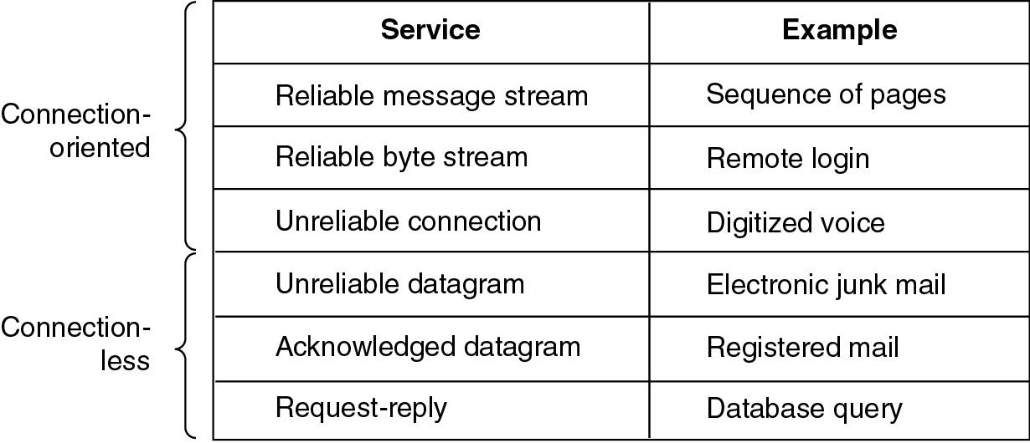
Connection-Oriented and Connectionless Services
Six different types of service.

Slide 13
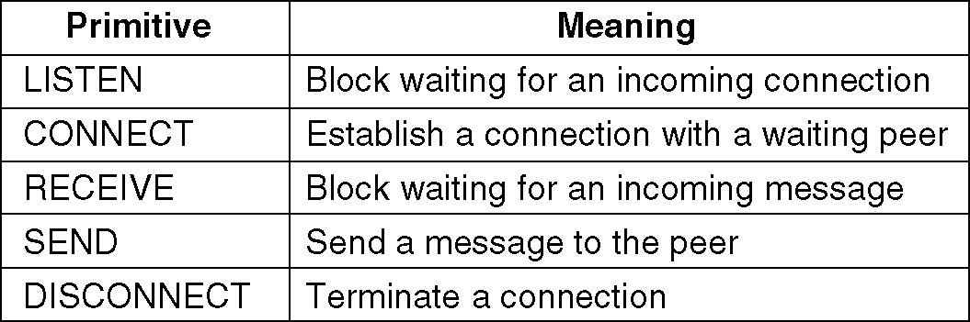
Service Primitives
Notes:
Five service primitives for implementing a simple connection-oriented service

Slide 14
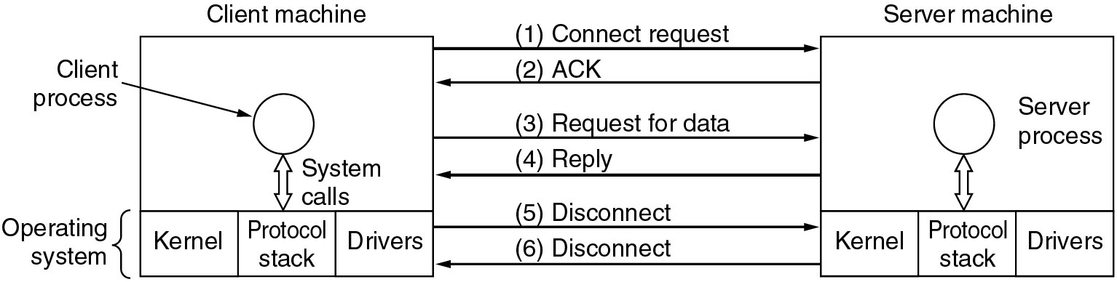
Service Primitives (2)
Packets flow between client and server

Slide 15
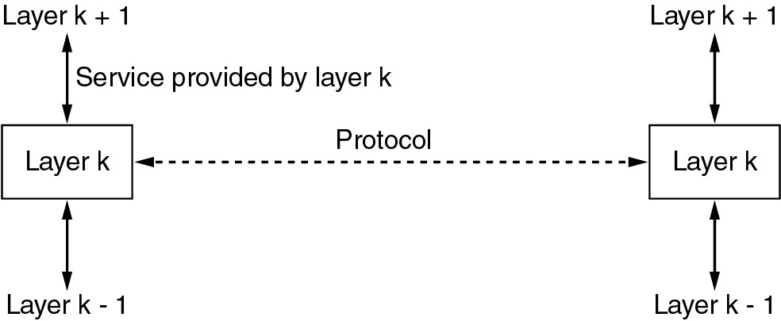
Services to Protocols Relationship
The relationship between service & protocol.

